Slide 1
The Case for Population-wide Salt Reduction
Lawrence J Appel, MD, MPH
C. David Molina Professor of Medicine
Director, Welch Center for Prevention, Epidemiology and Clinical Research
Johns Hopkins University School of Medicine
Nov 15, 2018

Slide 2
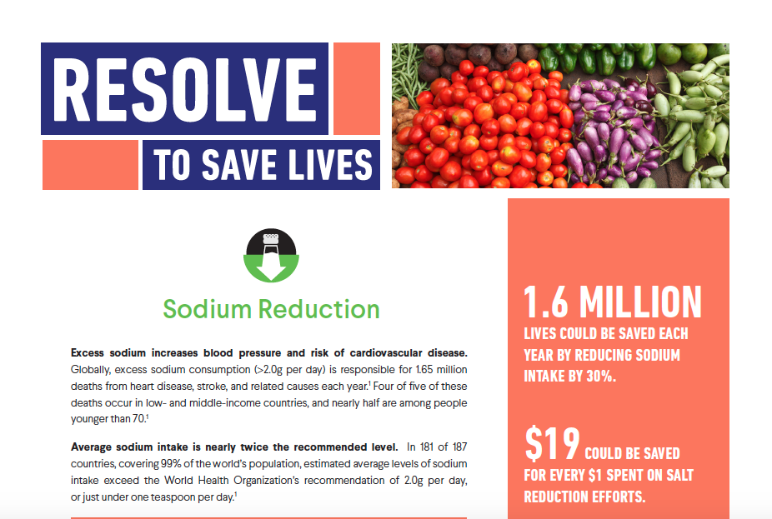

Slide 3
Outline
Worldwide pandemics of elevated blood pressure and cardiovascular disease (CVD)
Excess salt (sodium chloride) intake, a major cause of elevated blood pressure and CVD
Intake and sources of salt
A Pseudo-Controversy: Can salt reduction be harmful?
Lowering salt Intake, a global imperative

Slide 4
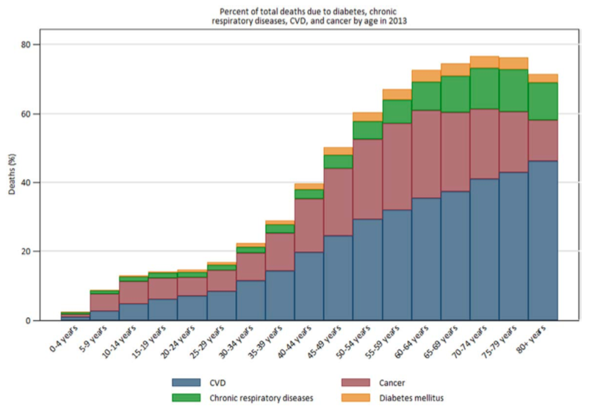
CVD is the Leading Cause of Death, Worldwide
CVD is the most common cause of death >40 years old
United Nations: 25% reduction in CVD deaths by 2025
Global and Regional Patterns in Cardiovascular Mortality from 1990 to 2013, Roth 2018
Notes:
https://www.ahajournals.org/doi/full/10.1161/CIRCULATIONAHA.114.008720?url_ver=Z39.88-2003&rfr_id=ori:rid:crossref.org&rfr_dat=cr_pub%3dpubmed
No animation – Complete NC

Slide 5
Major Modifiable Risk Factors for CVD
Major Modifiable Risk Factors for High BP
High blood pressure (BP)
Cigarette smoking
Elevated serum cholesterol
Diabetes
Excess salt intake
Insufficient potassium intake
Overweight/obesity
Suboptimal diet
Physical inactivity

Slide 6
Blood Pressure

Slide 7
As Blood Pressure Rises, So Does the Risk of Ischemic Heart disease, Ages 60-69 years old (Same for All Adult Ages, Same for Stroke)
SBP
DBP
256
256
128
128
64
64
32
32
IHD mortality
(absolute risk and 95% CI)
16
16
8
8
4
4
2
2
1
1
120
140
160
180
70
80
90
100
110
Usual SBP (mm Hg)
Usual DBP (mm Hg)
Lewington S. et al. Lancet. 2002;360:1903-1913.
Notes:
Make a copy
Change yellow line to black, remove all the other lines
Add people 60-69 in title
Complete NC

Slide 8
Big Picture: High BP is the Leading Cause of Preventable Deaths Worldwide
Source: http://ghdx.healthdata.org/gbd-results-tool, 2018
Notes:
Match orange bars with slide 6

Slide 9
Hypertension Prevalence and Absolute Burden in 2010, by Gender and Region
 | Prevalence | Absolute burden, millions
TOTAL | 31.1% | 1,388
High-income countries | 28.5% | 349
Low- and middle- income countries | 31.5% | 1,039
Mills, Circulation 2016;134:4441

Slide 10
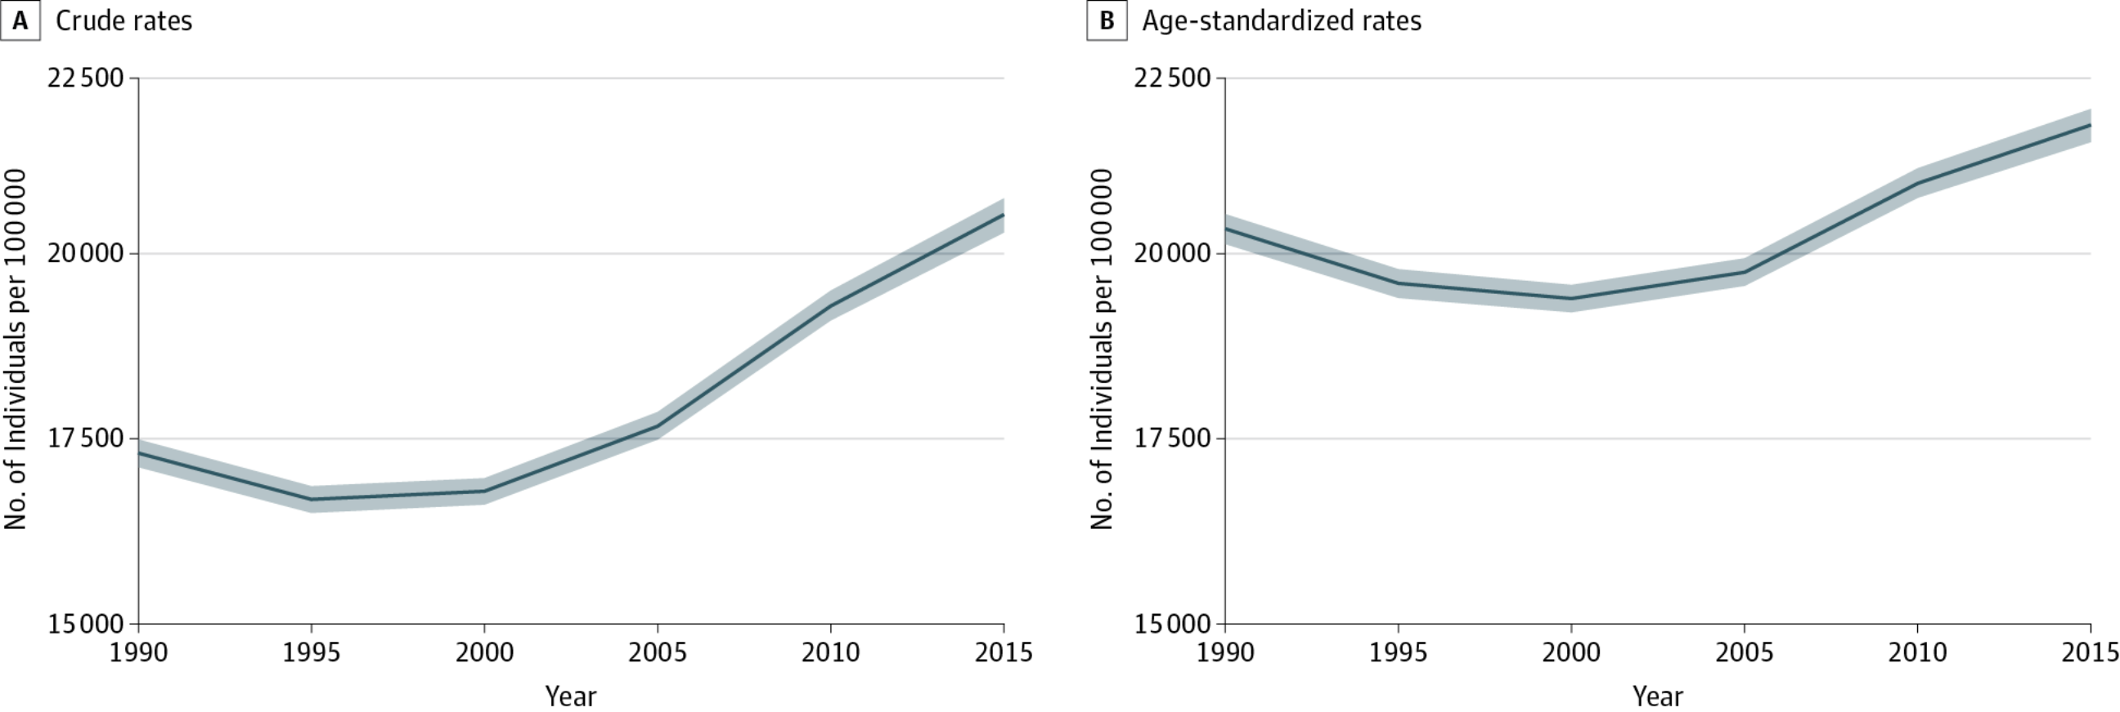
Worldwide, Rates of Hypertension (Systolic BP > 140 mmHg) are Increasing
Worldwide, Rates of Hypertension (Systolic BP > 140 mmHg) are Increasing
Forouzanfar, JAMA 2017 Jan 10;317(2):165-182

Slide 11
Prevalence of Hypertension Increases with Age:
U.S. Adults, Age 20+, by Age and Sex (NHANES: 2005-6)
Lifetime risk of developing hypertension is 90%
Men Women
NCHS Data Brief, Nov 2007;Vasan JAMA 2002; 287:1003
Notes:
Add legend

Slide 12
Prevalence of Hypertension Rises with Age in
Korean Adults (Lean Population): 2010 KNHANES
Percent of Population
Age (Years)
http://knhanes.cdc.go.kr/knhanes/index.do

Slide 13
Mean Systolic BP Rises with Age (U.S. Women)
Rise in Blood Pressure with Age Occurs in Most, but not All, Populations
SBP Rise with Age = ~0.6 mmHg per year
150
140
130
120
110
mm Hg
100
90
Black
80
White
Mexican-American
70
18-29
30-39
40-49
50-59
60-69
70-79
80+
Age
Burt, Hypertension 1995;26:60.
Notes:
Keep

Slide 14
In Populations with Extremely Low Sodium Intake, there is No Age-Related Rise in Systolic BP
4 Populations with No Rise in SBP with Age
0 1,150 2,300 3,450 4,600 5,750
0 1,150 2,300 3,450 4,600 5,750
INTERSALT BMJ 1988;297:319

Slide 15
In the Yanomami tribe, salt intake is extremely low and there is no age-related rise in blood pressure in children and adults, and no hypertension
Mueller, JAMA Cardiology, In Press

Slide 16
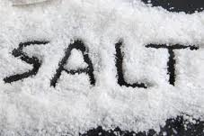
Salt Intake and Sources

Slide 17
WHO Recommendations for Salt Intake in Adults
Salt [Sodium Chloride] | < 5.0 gm
Equivalent to:
Sodium in mg | < 2,000 mg
Sodium in mmol | 87 mmol

Slide 18
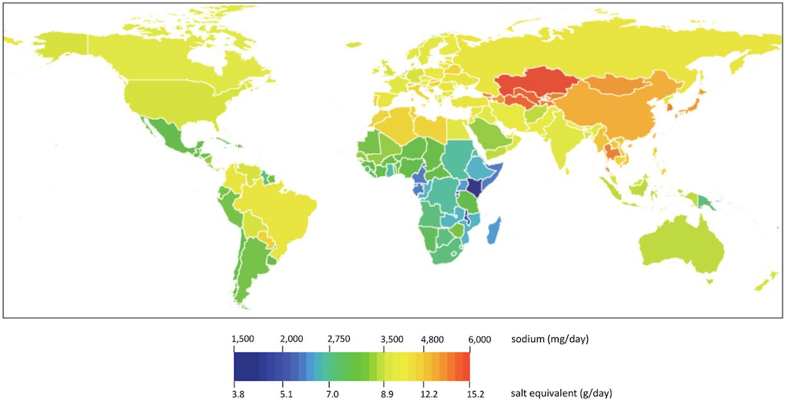
Worldwide, Salt Intake Greatly Exceeds 5 gm
WHO Limit
2010 Adult Sodium Intake by Country (Powles 2013)
Notes:
Powles J, Fahimi S, Micha R, et al Global, regional and national sodium intakes in 1990 and 2010: a systematic analysis of 24 h urinary sodium excretion and dietary surveys worldwide BMJ Open 2013;3:e003733. doi: 10.1136/bmjopen-2013-003733

Slide 19
Proportion of Salt Added to Food in 4 Countries
Anderson, INTERMAP, JADA 2010
Notes:
https://www.ncbi.nlm.nih.gov/pmc/articles/PMC4308093/
Bottom axis label – Complete NC

Slide 20
In US, Most Sodium (>70%) Comes from Processed and Restaurant Food
Harnack LJ, et al. Circulation. 2017;135:1775-1783.
Notes:
Low priority: change to same pie chart as slide 21

Slide 21
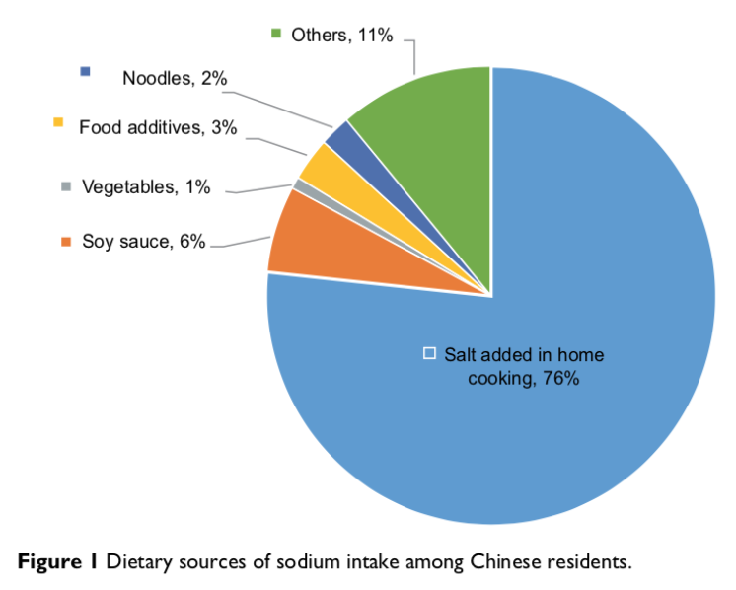
In China, Most Salt Comes from Salt added in Home Cooking
Shao 2017
Notes:
https://www.ncbi.nlm.nih.gov/pmc/articles/PMC5328139/pdf/rmhp-10-017.pdf

Slide 22
A Reduced Salt Intake Lowers Blood Pressure

Slide 23
Types of Evidence Linking Salt
Intake to Blood Pressure
Epidemiology | Over 50 population studies
Migration | Several, e.g. Kenya
Genetic | All defects identified so far impair the ability of the kidney to excrete salt.
Animal | All forms of hypertension are caused or aggravated by salt [rats, chimpanzees]
Trials | Children: ~10 trials, one trial in infants Adults: > 100 trials
Population Interventions | Northern Japan, Finland, United Kingdom

Slide 24
Reduced Salt Intake Lowers Systolic BP:
Meta-Analysis of 103 Trials
Mozaffarian, NEJM 2015;371:624

Slide 25
Estimated BP Reductions from Lowering Sodium Intake
 | Children¹ | Non-HTN² | HTN² | Resistant HTN³
SBP (mmHg) | -1.2 | -2.0 | -5.0 | -22.7
DBP (mmHg) | -1.3 | -1.0 | -2.7 | -9.1
Na (mg/d) Reduction | n/a | 1,700 | 1,800 | 2,300
¹He,HTN 2006;48:861 ²Cochrane Review, 2006; ³Pimenta, HTN 2009;54:475
Notes:
Keep

Slide 26
Who Should Benefit from Salt Reduction? Virtually Everyone
Salt reduction has been shown to lower blood pressure in:
Children
Adults without hypertension
Adults with hypertension, not on medication
Adults with hypertension, on medication
Prevention
Treatment

Slide 27
Salt Reduction is a Proven and Effective Public Health Strategy

Slide 28
Finland Experience: Salt Intake was Reduced, and
Blood Pressure and Stroke Mortality Fell
Started in 1978
Key features
Strong leadership, Finnish National Nutritional Council
Clear population targets with monitoring
Mass media campaigns
Stakeholder engagement
Voluntary cooperation with industry
Mandatory warning labels
Salt intake
(g/day)
Diastolic BP
(mmHg)
Stroke mortality
(1/100000)
Men
Men
Women
Women
Year
Year
Year
Karppanen & Mervaala. Prog Cardiovasc Dis 2006;49:59-75.
Notes:
Make 28 & 29

Slide 29
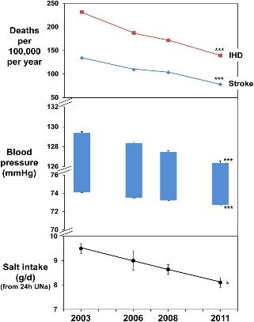
United Kingdom Experience: Salt Intake was
Reduced, and BP, IHD, and Stroke Mortality Fell
Implemented voluntary sodium reduction targets for industry
Industry initially resistant but then reduced sodium content of food
Sodium consumption reduced 15% and mortality from heart disease & stroke decreased 40%
He FJ et al. BMJ Open 2014; 4: e004549.
29

Slide 30
So Why the (Pseudo) Controversy About Salt Reduction?

Slide 31
Why the fuss about salt reduction?
Scientific issues specific to sodium
Methodologic ‘landmines’
Challenges of measuring sodium
Interpretation of low diet and low urinary sodium excretion
High cost of high quality sodium research in humans
Other scientific issues, not specific to sodium
Interpretation of unexpected j-shaped relationships in observational studies
Implications of non-BP effects of BP reducing therapies

Slide 32
Why the fuss about salt reduction?
Commercial interests
Cheap ingredient, increases profit
Role of government
Evidence to guide policy
Role of ‘surrogate outcomes’
Level of evidence for prevention policy when clinical trials with hard outcomes cannot be done

Slide 33

The Counter-Offensive Against Salt Reduction (US)
Fueled by commercial interests, including:
Chamber of Commerce
Salt Institute
With support from a handful of scientists

Slide 34
Arguments Against Sodium Reduction
Such trials are impossible because of logistical, financial and ethical considerations.
Clinical trial of sodium reduction with hard clinical outcomes is needed
Only ‘salt sensitive’ persons should reduce their salt intake
Sodium reduction might be harmful
No test available. Irrelevant given the massive scope of the blood pressure epidemic.
Extremely unlikely: 1) major methodological limitations of cohort studies + 2) over-interpretation of biomarkers

Slide 35
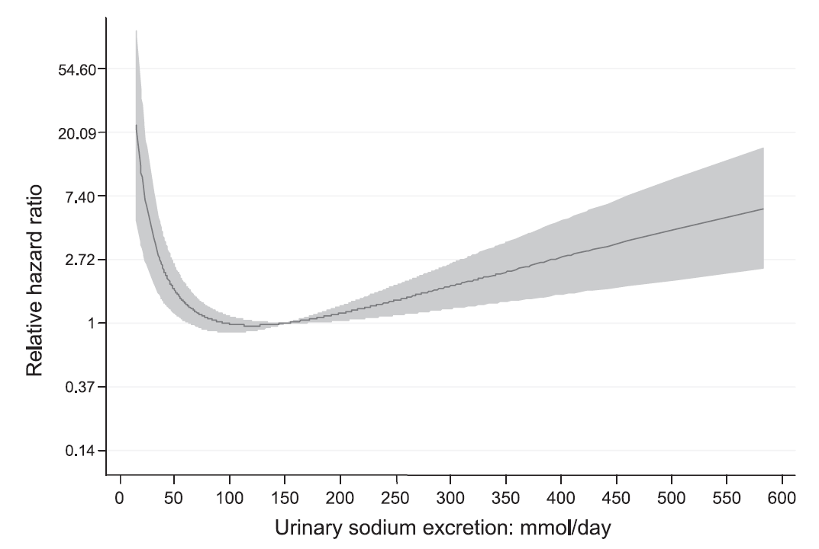
Spurious, J-Shaped Relationship of Total Mortality with Urine Sodium Excretion in Patients with Type 1 Diabetes
Extremely low levels are most likely the result of extreme undercollection
Thomas, Diabetes Care 2011: 861-6

Slide 36
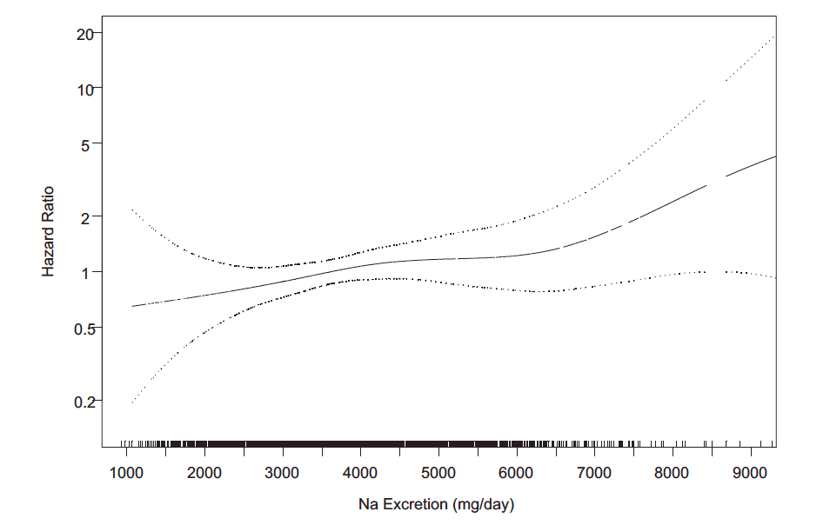
Best Available Evidence: Direct, Progressive Relationship of CVD with Urinary Sodium Excretion* in 2,275 Individuals with Prehypertension
*Based on 24 hr urine collections (median = 5)
Cook, Circ 2014:129:981
Notes:
Block out the top and bottom line charted; center line only
Complete - NC

Slide 37
Summary
Elevated blood pressure, present in 1.4 billion persons, is the leading preventable cause of mortality
Salt reduction lowers blood pressure and should prevent heart disease and stroke
No credible evidence of harm from salt reduction

Slide 38
Salt Reduction Will Benefit Virtually Everyone
Bottom Line

Slide 39
Thank you for Listening !! Questions ??

Slide 40



Slide 41
Extra Slides

Slide 42
High BP is Leading Cause of Preventable Deaths in Low-Middle and High Income Countries
Source: http://ghdx.healthdata.org/gbd-results-tool, 2018

Slide 43
Most People With Hypertension Do Not Have Their Blood Pressure Under Control
1.4 Bn
Less than 1 in 7 with hypertension worldwide have it under control
734M
489M
192M
<14%
Mills KT et al. Circulation. 2016 Aug 9;134(6):441-450.
Notes:
Despite the heavy burden of illness and death from hypertension, many countries have been slow to respond. Just over half with HTN know they have it and just 1 in 7 globally have it under control. These proportions are significantly higher in LMICs. Yet HTN is probably the easiest to treat and effective treatment is available and can be relatively inexpensive.

Slide 44
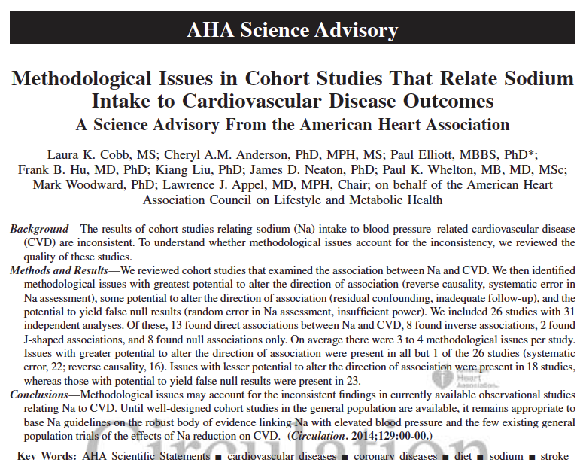

Slide 45
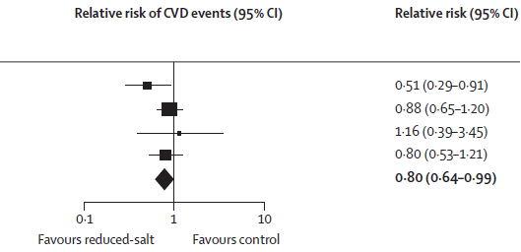
Sodium Reduction Lowers CVD Risk: Meta-Analysis of Trials
Events
Na/Cntl
Trial
TOHP I 17 / 32
TOHP II 71 / 80
Morgan 6 / 5
TONE 36 / 46
Total 130 / 163
He FJ, MacGregor GA. Lancet. 2011;378:380–382

Slide 46
Paradoxical Relationships
Example: an inverse, u-shaped, or j-shaped relationship when a direct relationship is expected
Common in medical literature
Methodological issues likely responsible for many of these relationships:
Reverse causality
Measurement errors
Selection biases
Critical issue: is the paradoxical relationship causal?

Slide 47
Options to Estimate Usual Sodium Intake of Individuals
Optimal
Multiple, high quality 24 hour urine collections
Suboptimal
Single* or poor quality 24 hour urine collection
Spot, overnight or timed urine
24 hour dietary recall
Food frequency questionnaire
*Single 24 hour urine is fine for estimating group average

Slide 48
Effects of Sodium Intake on CVD
Expected relationship: Direct, progressive
Substantial indirect evidence
Increased sodium intake → Increased BP
Increased BP → CVD and Stroke
Most rigorous observational evidence
TOHP Phase III
Secondary analyses of trials
TOHP, TONE, Morgan
Unexpected relationship: J-Shaped or Inverse Relationship
Observational studies of poor quality

Slide 49
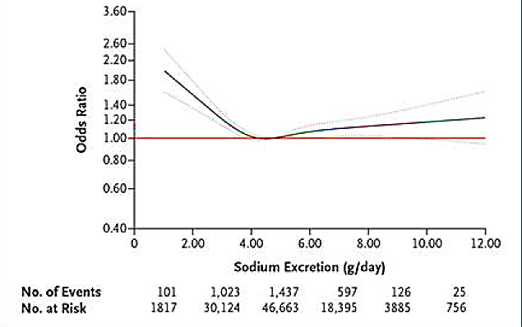
Estimated Sodium Excretion (from early morning void) and Risk of Death or CVD Events in PURE Study (n=101,945)
O’Donnell. NEJM, August 2014

Slide 50
Four Estimates of Urine Sodium Excretion in TOHP
Measured sodium (from 24hr urine)
1) First 24hr urine
2) Average of multiple 24hr urine
Estimated sodium (from Kawasaki formula)
3) First urine
4) Average of multiple
**Different measures of sodium intake led to different results, i.e. result is analysis dependent**
He, IJE 2018

Slide 51
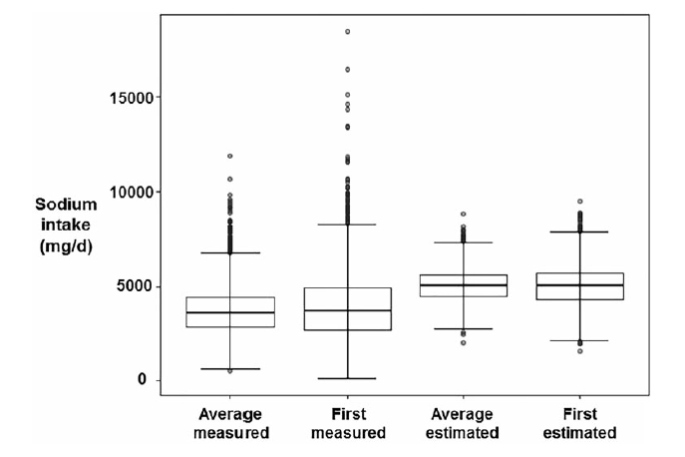
‘Estimated’ Urine Sodium is Higher than ‘Measured’ Urine Sodium
He, IJE 2018

Slide 52
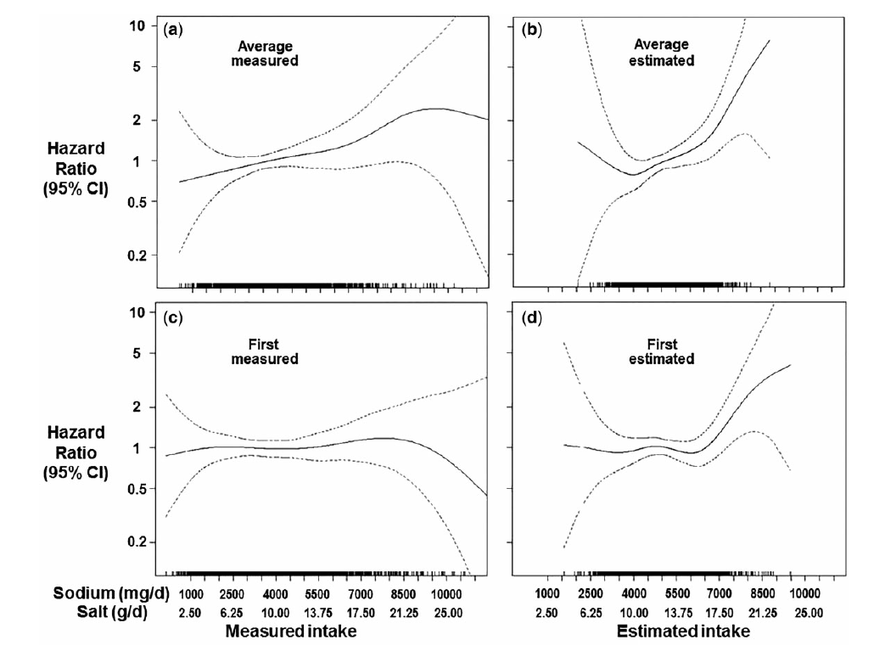
In TOHP3, Relationship of Mortality with Urine Sodium Differs by Type of Urine Sodium Measurement
He, IJE 2018

Slide 53
Examples of J-Shaped Relationships, Likely Non-Causal
Obesity paradox: U- or J-shaped relationship of mortality by body mass index in patients with diabetes, CVD, CKD, heart failure, etc
Coronary heart disease events by diastolic blood pressure

Slide 54
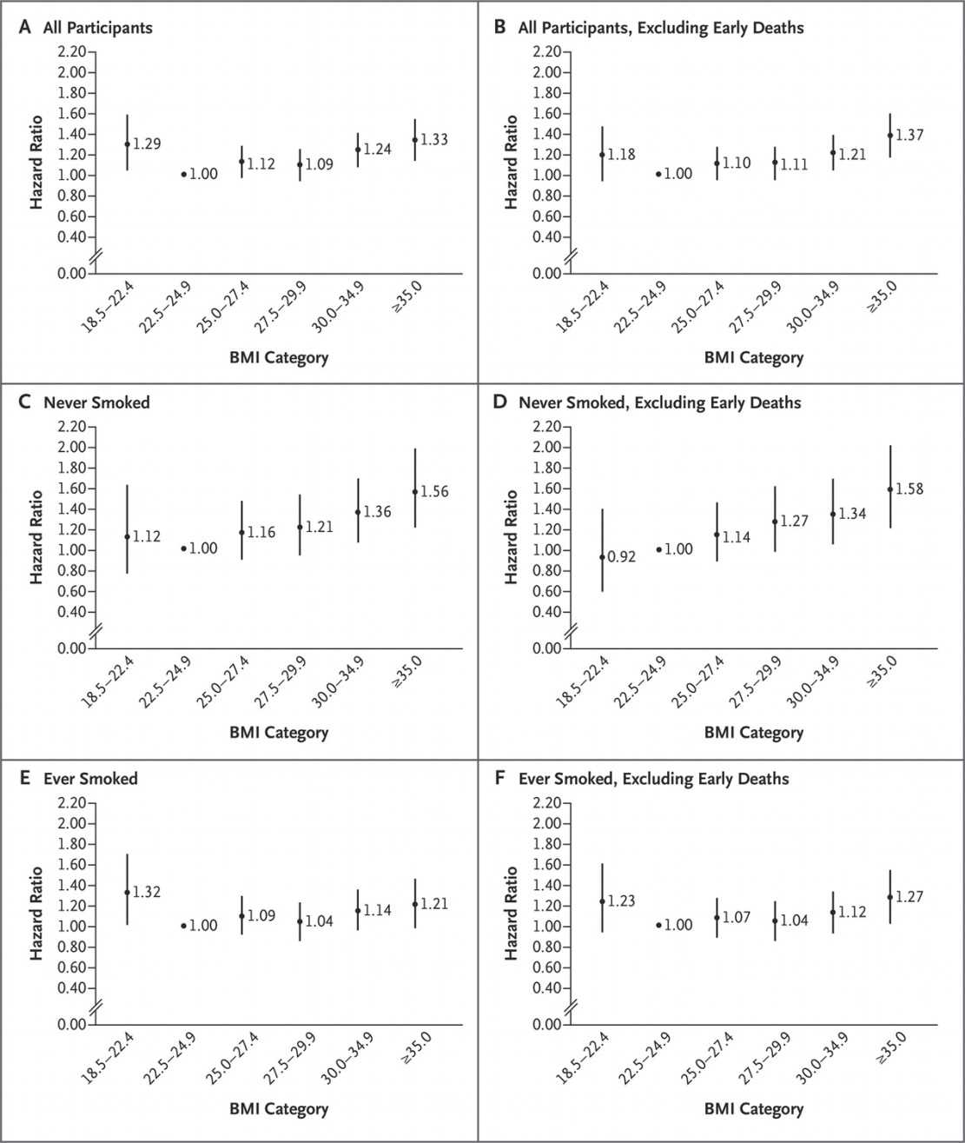
All Cause Mortality in Persons with Incident Diabetes (All Participants): J-Shaped Relationship with BMI
Tobias, D. K., et al. (2014). "Body-mass index and mortality among adults with incident type 2 diabetes." N Engl J Med 370(3): 233-244.

Slide 55

All Participants, Excluding Early Deaths: Attenuated J-Shaped Relationship
Tobias, D. K., et al. (2014). "Body-mass index and mortality among adults with incident type 2 diabetes." N Engl J Med 370(3): 233-244.

Slide 56
Restricted to ‘Never Smokers’: Attenuated J-Shaped Relationship
Tobias, D. K., et al. (2014). "Body-mass index and mortality among adults with incident type 2 diabetes." N Engl J Med 370(3): 233-244.

Slide 57
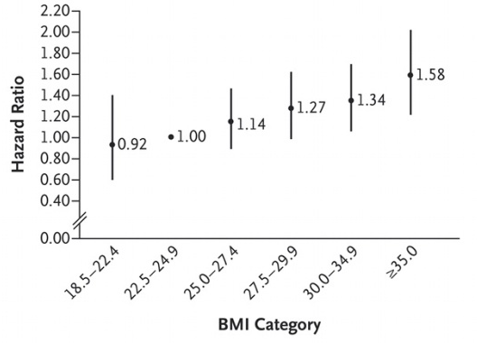
Restricted to ‘Never Smokers’, Excluding Early Deaths: Direct, Progressive Relationship
Tobias, D. K., et al. (2014). "Body-mass index and mortality among adults with incident type 2 diabetes." N Engl J Med 370(3): 233-244.

Slide 58
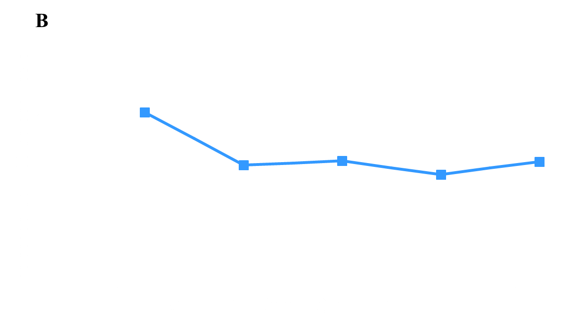
Inverse Relationship of Total Mortality by Baseline Diastolic BP in Standard BP Group in SPRINT [Raising Concern that Intensive BP group which Lowered Diastolic BP might Increase, not Decrease, Mortality]
Standard
Beddhu, Circulation 2018;137:134 (adapted from figure 2b)

Slide 59
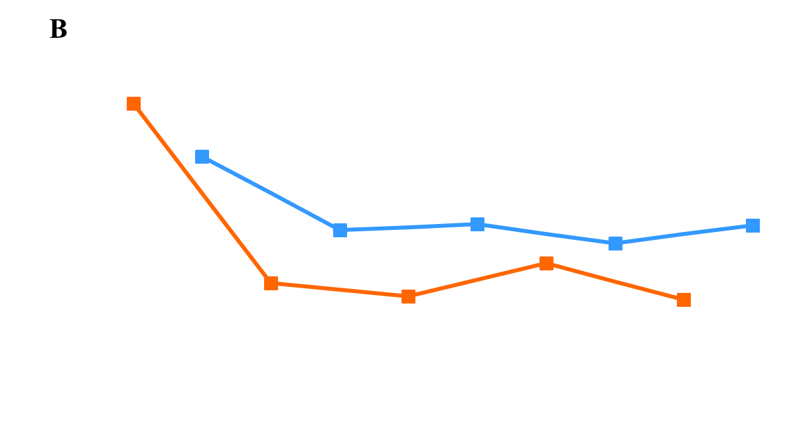
Hypothesized Pattern in SPRINT IF Lower Diastolic BP were Causally Related to Total Mortality (Increased Mortality at Low Diastolic BP)
Hypothesized data point if harm (all other data points actual)
Intensive Standard
Beddhu, Circulation 2018;137:134 (adapted from figure 2b)

Slide 60
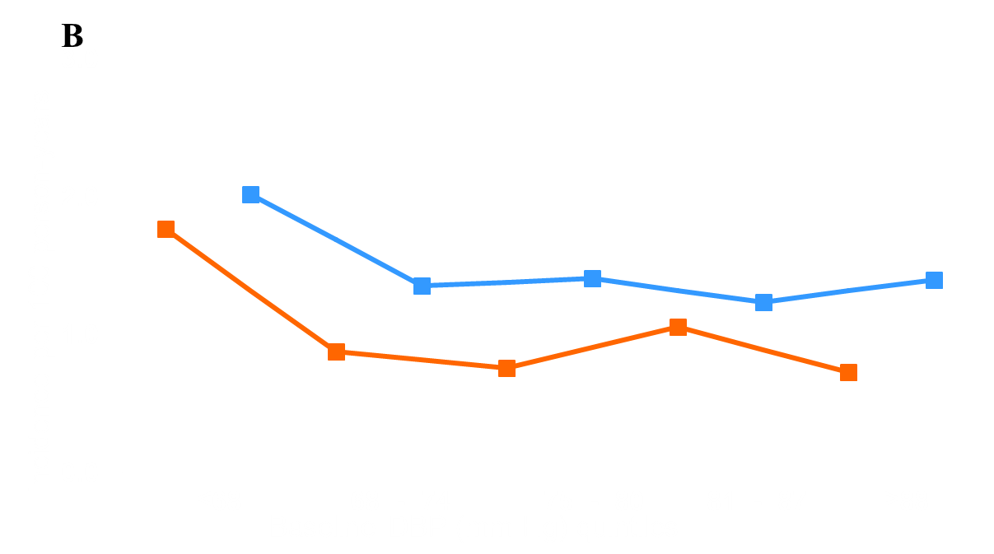
Actual Results: Intensive BP Goal Shifted ‘Inverse Relationship’ of Total Mortality Downward (Decreasing, not Increasing, Mortality at Low Diastolic BP):
Evidence that Inverse Relationship of Total Mortality with Diastolic BP is Non-Causal
Intensive Standard
Beddhu, Circulation 2018;137:134 (adapted from figure 2b)

